Slide 1
RWD implementation Audience: Development Studio

Slide 2
Prerequisites for this training:
Fully versed in our existing development methodology
Fully versed in the RWD introductory presentation
Familiarity with these terms: Mobile First and Progressive Enhancement
Reviewed both Content Strategy and Event Apart DigiKnow presentations
Know your team members and the tasks they are responsible for
Awareness of your part in the Planning and Executing phases
Looking forward to collaborating even more with your key team members at the Planning and Executing phases

Slide 3
TMP’s Development Methodology
Notes:
The prerequisites for this training are that you are fully versed in our existing development methodology

Slide 4

RWD Introductory Presentation by Spell and James
Notes:
Fully versed in the definition of responsive web design.

Slide 5
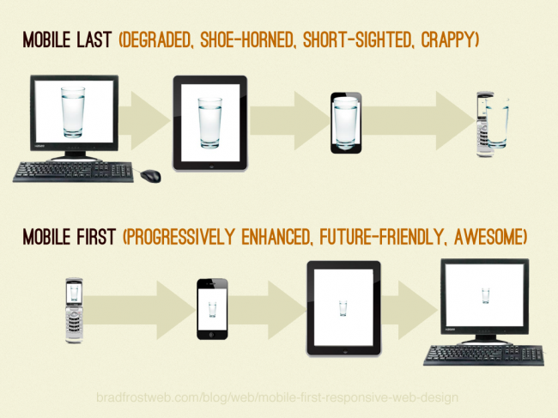
Mobile First
“Rather than the traditional approach of starting with the ‘desktop version’ of a website and then simplifying it for mobile, begin by building sites that work well on small-screen, portable devices, then build up from there.”
- Luke Wroblewski
Notes:
Familiar with the term: Mobile First

Slide 6
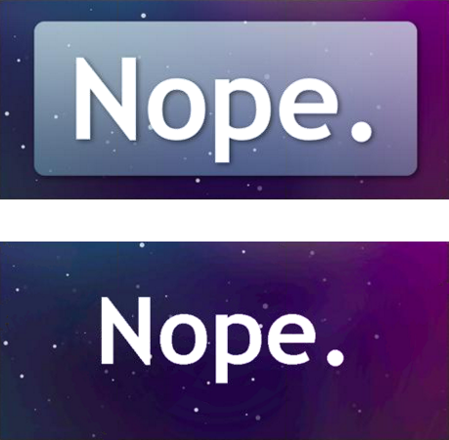
Progressive Enhancement
Progressive enhancement is a
development strategy used to build sites with baseline devices in mind while layering in a richer experience for users with more modern browsers or devices.
Notes:
and the term: Progressive Enhancement
Building with progressive enhancement at the forefront of our thoughts will allow us to create web sites that are compatible with different devices, are easier to maintain and can be accessed by everybody, regardless of the browser they are using.

Slide 7

July DigiKnow’s Content Strategy presentation by Yvette
Content is KING!
Creating, offering, serving, and supporting interesting, actionable, sharable content is vital.
Content is out there. It happens.
We need to control it. And manage it.
Not MORE.
More MEANING.
Notes:
Reviewed both the Content Strategy…

Slide 8
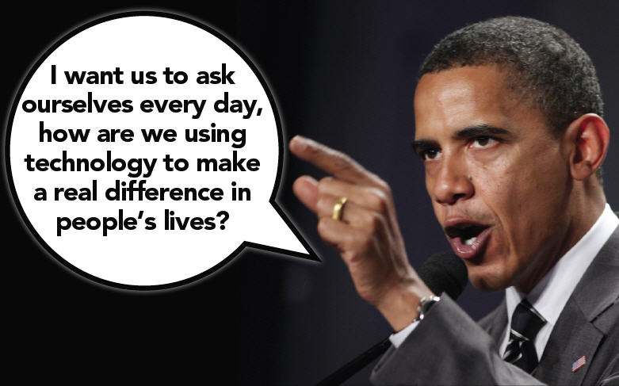
Sept DigiKnow’s Event Apart presentation by Dan and Mark
You don’t get to decide which device people use to access your content. They do.
Disruptive technologies eventually get good or they redefine what good is.
There are 50 million Americans who only use a mobile device. How are you serving them?
Notes:
…and Event Apart DigiKnow presentations.
You know your team members and the tasks they are responsible for…
Aware of the part you play in the Planning and Executing phases…
And looking forward to collaborating even more with your key team members at the Planning and Executing phases.

Slide 9
Incorporating RWD into our world
Notes:
Think of this as a movement, a movement we’ve been driving towards for some time now. Currently, several of our team members have already launched two responsive sites (Capital One and Bank of America) and are in the process of completing TD Ameritrade and Union Pacific.
A few of us have attended Meetups where the focus was supposed to be how to incorporate RWD into your current practice. We came out of a few of those meetings feeling like we were a bit ahead of the game, as the conversations centered more around the “what’s” and the “why’s” rather than the “how’s”.
So, we’ve been working on modifying our “process” and had the fortunate opportunity to test it out and make necessary adjustments during development of the projects we just mentioned. We are looking for your questions and feedback as we share this process with you over the next few slides.

Slide 10
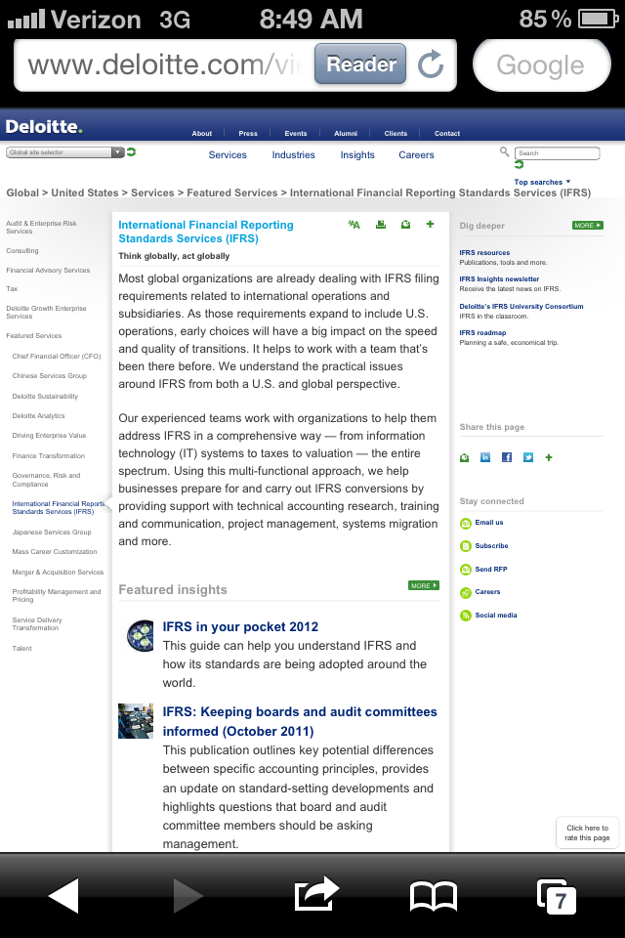
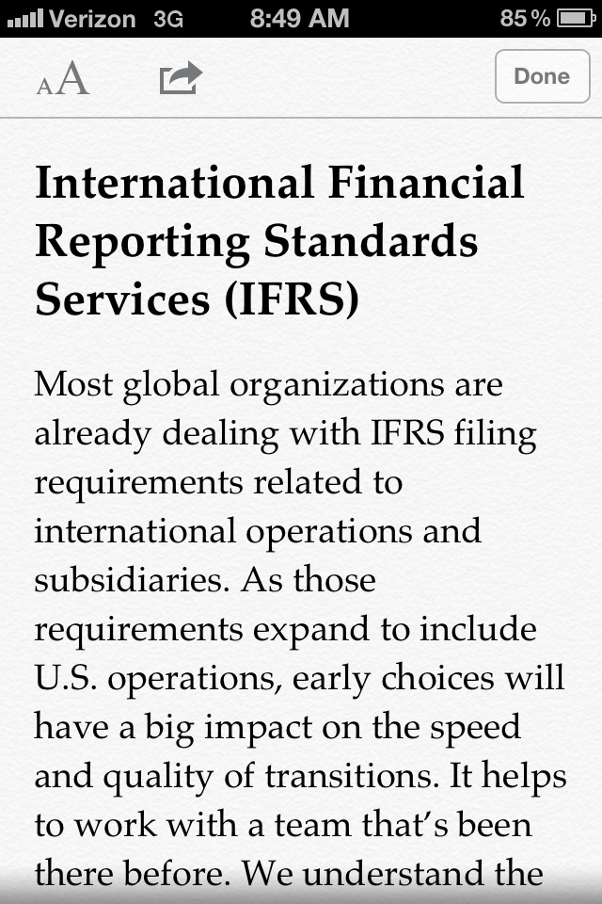
The way forward…
Notes:
Before we get into the process, I’d like to return our attention to the first point on Slide 8: You don’t get to decide which device people use to access your content. They do.
That is a pretty powerful point.
The user has all of the control on the web, so it behooves us to create as pleasurable an experience on as many devices as we can. If we don’t give users what they want, they will find other ways to access and consume that information. Built in browser functionality, like iOS Reader, user style sheets and services like Readibility or Instapaper can render all of the hard work we put into the creation of a site useless. Nobody wants that (especially our clients).

Slide 11
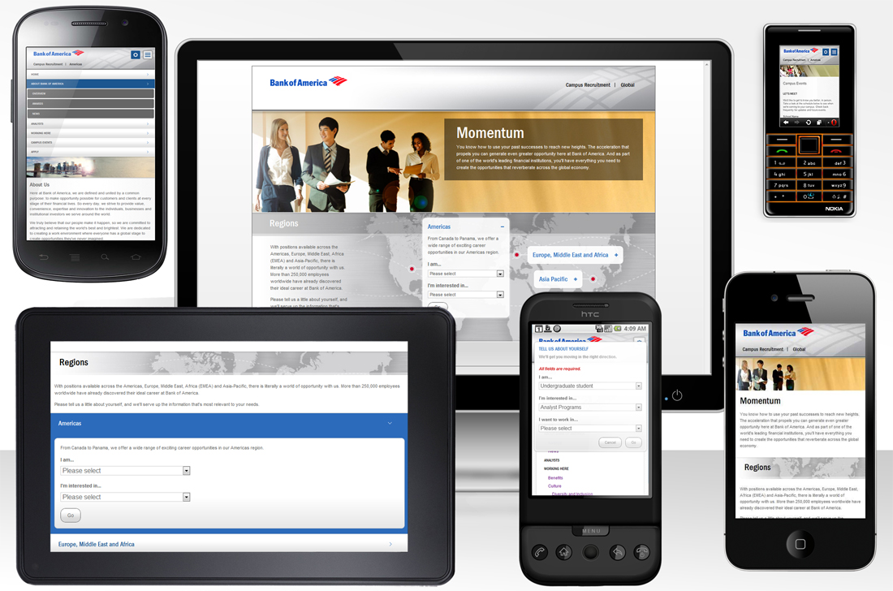
The way forward…
Understand user needs
Plan your content strategy during the strategic planning phase
Focus on the core message and progressively enhance that message
Collaborate with your team during development
Notes:
In order for TMP to embrace the future of the web, it has become apparent that a different process is required to handle the successful delivery of our client's web presence.
TMP needs to focus on our client’s core message and then progressively enhance that message and experience on more capable devices. We are no longer tied to our desktop browsers and must take a somewhat more agile approach to design and development so that we can accommodate the many different devices on the market today as well as the devices of tomorrow.
Through adherence to web standards and the principles of progressive enhancement, we have the technical ability to create sites that meet the growing demands of mobile usage. However, this is only part of the solution. There is more to it than just scaling a site down to fit on mobile. Understanding user needs, content strategy and more team collaboration should continue to be our top priority as it is only through this that we will successfully create great, responsive web for all.

Slide 12
What’s different and what’s staying the same?

Slide 13
What’s staying the same
We are still:
Following the same development methodology
Working with the same team members
Providing deliverables AND rounds of review for each deliverable.
We’re still delivering a website experience!
Notes:
Let’s start with “What’s staying the same”, because we are still:
Following the same development methodology where we hold discovery and solutions meetings and identify, as a team, the project goals, determine requirements and put forth a solution in the form of a “scope of work” document.
Working with the same team members in creative and digital development: Producers, Digital Project Managers, Interaction Designers, Creative Designers, Copywriters, Developers and Quality Assurance Technicians.
Providing deliverables such as content (copy, video, images, etc.), sitemaps, wireframes, business rules, design comps, test plans, QA sites, live sites, etc. AND rounds of review for each deliverable.
We’re still delivering a website experience!
While this will evolve as we gain more knowledge, we will work within the current structure we have at TMP with the available resources.

Slide 14
What’s different
So “what’s different”…
More formal collaboration with internal team members – with heavy emphasis on strategic planning
Scheduled “implementation meetings” and “internal team reviews”
Prototype development
Concurrent development throughout the implementation phase
Notes:
During the planning and implementation phases our internal team is going to collaborate in a much more formal manner during each stage of development – with heavy emphasis on Strategic Planning.
We have identified times for “implementation meetings” and “internal team reviews” to ensure the stability of the experience before anything is shown to the client. Specifically, ensuring the deliverables are meeting the requirements of the scope AND are following usability and coding best practices. What we mean by implementation meeting is that prior to a deliverable the lead of that deliverable has an opportunity to collaborate with the internal team on the best way to move forward.
Prototype development will begin once content outline and wireframes are approved. By prototype we mean, a working wireframe that the developer will code based on the approved wireframe. It gives the internal team an opportunity to test the functionality of the site as it translates from the “static” wireframe to a “dynamic” one. It also provides the creative team a leg up on how they can begin designing pages throughout the site.
Concurrent development throughout the implementation phase will occur. Teams will work in tandem throughout the implementation phase.
The bottom line is the days of the assembly line are over!

Slide 15
Are we “Agile” now?!?
No.
We are not switching to an Agile Methodology, rather we are working in an agile nature to allow for the necessary collaboration in building an online destination that can be used on any device.
We need to modify our workflow to support a responsive experience.
Notes:
Some of you may be asking “are we agile now”? And the answer is no.
We’re not switching to an agile methodology, rather we’re working in an agile nature to allow for the necessary collaboration between team members during the implementation stage. We are modifying only our workflow to support a responsive experience.

Slide 16
TMP’s Development Methodology
Revisited
Notes:
Let’s take a quick look back at that methodology before we get into the implementation…

Slide 17
TMP’s Development Methodology
Determine user needs & business goals
Solutions, planning, content strategy, scope/estimate/timeline
Implementation meetings & internal reviews on all deliverables, prototype
Review analytics, plan future phases & maintenance
Notes:
We’ve taken the graphic that you’re used to seeing and highlighted a few things from each stage on the left.
During Discovery, to help us determine if a responsive website, adaptive website or separate experiences are needed, we still have to find out who our target audience is, typical use cases, environment or technology considerations and budget. Can any site be made responsive? Yes, but not focusing on the user needs first and understanding what is learned from discovery, you can harm the user experience. Remember, it’s about identifying the best solution for the user needs and business goals.
During Strategic Planning, careful planning needs to occur upfront with a level of detail that we unfortunately don’t always see at this stage. Identifying the content strategy, tasks for each deliverable, determining the number of implementation reviews and internal reviews for each, and developing the project estimate and timeline based on this information needs to be identified here – not after we’ve delivered a scope, estimate or timeline to the client.
Implementation meetings and internal reviews with team members should be accounted for in the estimate during the planning stage. This should not scare anyone. Planning for the time and hours upfront will keep you within budget and mitigate risk to the project. Issues with technical execution of design will be identified and remedied early in the project AND prior to delivery to the client.
There might be a concern that we would go into a project already over budget with all of these meetings. We will not, if we plan ahead and identify the hours of effort for all meetings, tasks, deliverables, etc., for a project, then go into that project well prepared with the ability to set appropriate client expectations.
I will note that we’ve added one additional deliverable to the Implementation phase – the prototype. But we’re going to talk about that coming up.
Regarding results and measurement of success, discussions during the Discovery and Strategic Planning phases should outline what is expected. Regardless of the solution, you will want to plan on capturing the type of metrics that will help us and the client understand how users are accessing your site so that the most appropriate maintenance plan and/or future enhancements can be determined.
So again, nothing very different from what you already know here.

Slide 18

Content is KING – especially with RWD
Content drives design.
Must be determined first, before development can begin.
Most important content goes to base line experience first (mobile) and is built upon and enhanced with supplementary content as the device grows in size or is more capable.
Notes:
Before we get into Implementation, it’s worth repeating that the content strategy for the site (which is based on the recruitment brand messaging) must be fleshed out during the strategic planning phase of the project.
The Producer will lead this initiative and collaborate with the copywriter, creative designer and interaction designer during solutions meetings to establish this.
You may be asking “What if TMP’s not supplying the content? “ Even if that’s the case we still need to identify the focal point of content that lays the foundation for the site. I know this may be a hard one to swallow given the reality of how clients deliver “final” content, but we have to try. Part of our message to our clients needs to be how critical developing the content strategy is to the success of their site.

Slide 19
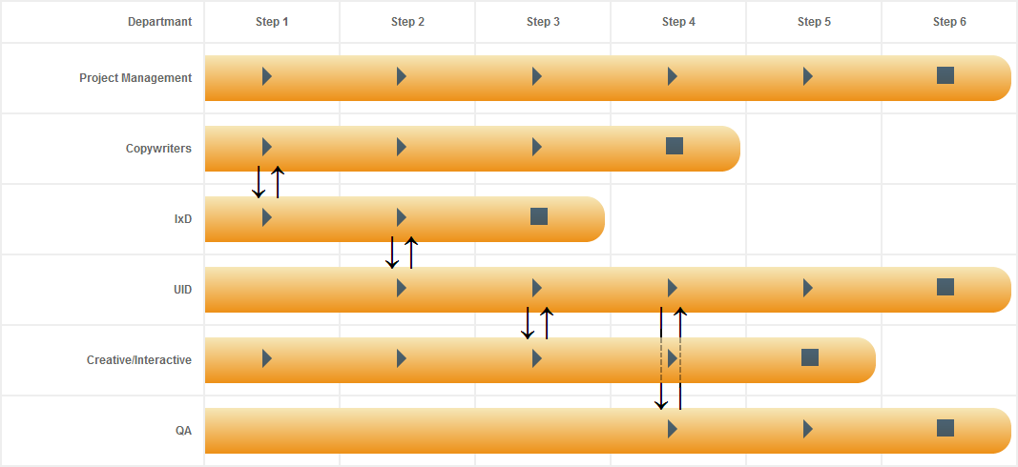
The Responsive Process
Notes:
With that said, let’s take a look at Implementation and how we’ve modified our workflow. We provided a visual but will go into more detail over the next few slides of what this all means. We’ve listed the department roles along the left side and along the top a number of steps that are typical when developing an online experience. The “play” button represents when a team member will play an active part. The “stop” button assumes when the team member will finish their part. The double arrows represent key areas of collaboration.
-----

Slide 20
Implementation Step 1: Collaboration emphasis on IxD and Copywriter
The copywriter and interaction designer collaborate on:
Wireframes
High level business rules
Content development
The creative designer begins concept development.
Mood board comps
Notes:
Assuming you have worked out the content strategy in the planning phase and documented it accordingly in the scope, estimate and timeline, we’ll start with collaboration emphasis between the Interaction Designer and the Copywriter. They will be responsible for their own deliverables but will collaborate on wireframes, high level business rules and content development, while the creative designer begins concept development.
You may be asking, what if the client saw designs presented during a TMP pitch, and they want them exactly as they are, what do we do? We need to set the right expectation during the pitch on what these designs mean and how they could change during actual development once we have more info (or the right info) to provide the best possible solution (remember the slug for all design comps). All of this should be discussed and taken care of during the planning stage, not during implementation.

Slide 21
Implementation Step 2: Collaboration emphasis on IxD and UID
The interaction designer and user interface developer collaborate on:
Working prototype*
Business rules
The copywriter continues with copy development for the site.
The creative designer continues with concept development.
Notes:
With wireframes approved, collaboration emphasis is then between the interaction designer and the user interface developer. This is the time when prototype development can begin.
The copywriter will continue with copy development and the creative designer will continue with concept development.

Slide 22
Implementation Step 3: Collaboration emphasis on Creative and UID
The creative designer, user interface developer and interactive developer collaborate on:
Fleshing out all page designs*
Expanding on the prototype
Storyboards (needed between creative designer and interactive developer)
The copywriter continues with copy development for the site.
The interaction designer is brought in to collaborate on usability concerns where/if needed.
Notes:
The prototype provides the creative team a more dynamic view of how the site will begin to take shape and how they will apply creative concepts to the site. Collaboration emphasis during this time is between the creative designer and user interface developer where the focus is on fleshing out all of the page designs and expanding on the prototype. If interactive design and development is required, this is also where the teams will collaborate to create appropriate storyboards.
The copywriter will continue with copy development and if there are any usability concerns, the interaction designer will be brought in to consult on any usability issues.

Slide 23
Implementation Step 4: Collaboration emphasis on UID and QA
The QA lead and user interface developer collaborate on development of appropriate test plans.
The creative designer continues to supply any needed images/graphics/creative elements for the site.
The copywriter supplies final copy for the site.
The interaction designer is brought in to collaborate on usability concerns where/if needed.
Notes:
The site is now taking shape. At this time, collaboration emphasis is between the user interface developer and the quality assurance technician. This is where the testing plans are finalized. This includes identifying any specific accessibility needs as well as, browser, platform and/or environment requirements outside of our standard TMP list that were identified in the scope.
The other team members would continue to fine-tune or in some cases finalize their deliverables in preparation for testing.

Slide 24
Implementation Steps 5/6: Collaboration emphasis on UID & needed teams
During step five:
The user interface developer finalizes all programming.
The QA lead and user interface developer collaborate on identifying and resolving bugs/defects that are more functional in nature.
The creative designer is brought in to supply any assets needed based on client/internal revisions and/or bugs found.
The copywriter is brought in to supply any copy updates needed based on client/internal revisions and/or bugs found.
Notes:
The remaining steps center on the user interface developer leaning on needed team members to finalize all programming and updates to content assets.
The QA lead will continue to test and identify any bugs or defects found in preparation for launch.

Slide 25
Implementation Steps 5/6: Collaboration emphasis on UID & needed teams cont.
During step six:
The user interface developer confirms the site is ready for final testing.
The QA lead performs all final testing (including testing of copy, images, assets, etc).
Client signs off on UAT.
Notes:
Lastly, the site is approved by both TMP internal teams and the client and is ready for launch.

Slide 26
Where is my Producer or DPM in all of this?
Your Producer or Digital Project Manager is they are in every step of the implementation process and will continue to:
Lead project initiation (Discovery) and strategic planning
Work with the team to develop the project plan and scope of work
Monitor the triple constraint (scope, estimate, timeline)
Provide weekly performance reports on the project
Identify risks if there are variances in what was originally planned
Coordinate and schedule implementation meetings and internal reviews
Liaise with account services and client teams on all areas of the project
Notes:
You may be asking – where is my Digital Project Manager in all of this. And the answer is they have never left you. They will continue to be the lead point person throughout the project.

Slide 27
In closing…
Understand user needs
Plan your content strategy during the strategic planning phase
Focus on the core message and progressively enhance that message
Collaborate with your team during development
Notes:
In closing, let’s recap the important points.
Understand user needs.
Plan your content strategy during the strategic planning phase.
Focus on the core message and progressively enhance that message.
Collaborate with your team during development.
The web is still in it’s infancy, so it is exciting to think that we are all helping to shape the standard in our industry when it comes to new techniques like Responsive Web Design. In the future, we’ll continue to have platforms like the Digiknow , Case Studies and other departmental communications to reflect upon and review, but we also need a pioneering attitude to help shape how we are moving forward as an agency and stay ahead of where technology is going.

Slide 28
Questions?
Notes:
Below are some questions that generated discussion among the team.
Can I talk to my team member without the DPM?
Yes, but check with your DPM on the hours and timeline you’re working within so you don’t go over budget.
Do I have to stay within the 6 implementation rounds?
It depends on the project. What you do need to follow is the established flow of communication among team members during key areas of the project.
When can I show the client “stuff”?
While you can have several rounds of review within each stage, the number of rounds and deliverables will vary from project to project and depends on what your team sees as the best approach during the planning phase.
What is the difference between an implementation meeting and an internal review?
The implementation meeting includes the internal team members who are working on the tasks/deliverables within a particular implementation stage. The internal review is a time for the team to review the work and address potential issues before showing the client.
How frequently do we have implementation meetings?
During those stages of implementation where you are collaborating with your team members and developing deliverables.
How frequently do we have internal reviews?
Any time you plan on sending a deliverable to the client, you should have already had an internal review and modified the work accordingly to set the proper expectation.

Slide 29
Thank you!
Notes:
Contact Michael Spellacy or Ann Marie Dellaccio with additional questions.

